Slide 1
APP PRESENTATION: IRC CLIENT
Do Duc Minh
22BI13279
Tran Duc Manh
22BI13274
Do Ba Hoang Minh
22BI13278
Hoang Duc Nghia
22BI13329
Tran Binh Minh
22BI13308
Group 1
Do Duc Minh | 22BI13279
Tran Duc Manh | 22BI13274
Do Ba Hoang Minh | 22BI13278
Hoang Duc Nghia | 22BI13329
Tran Binh Minh | 22BI13308
Do Duc Minh | 22BI13279

Slide 2
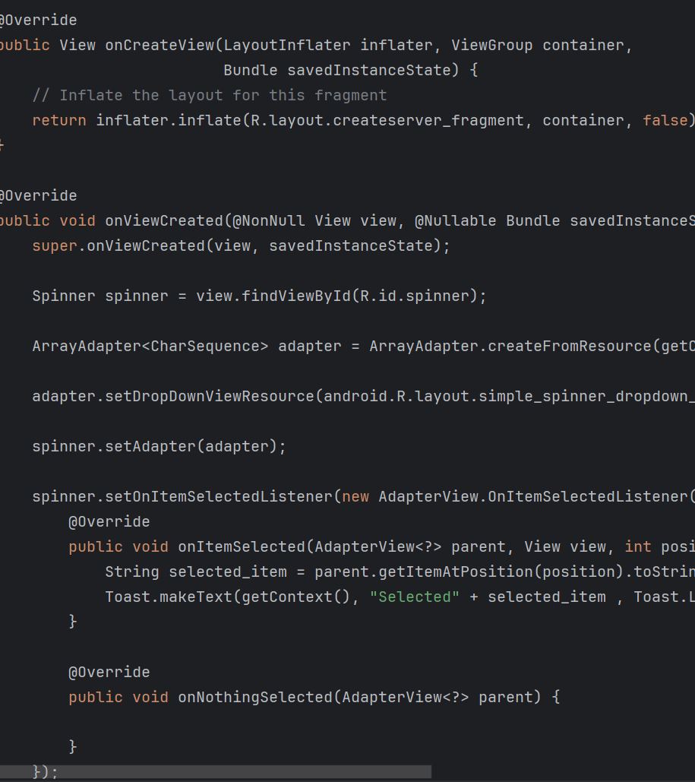
GOAL AND
INTRODUCTION

Slide 3
ABOUT IRC
IRC (Internet Relay Chat) is a real-time messaging protocol where users can chat in public channels or privately. It’s commonly used in tech and gaming communities.
Open-source, federated, and easy to extend, functioning as a protocol not governed by a single entity.

Slide 4
Context
Requirement: Group and community current communication.
Current Solution: The currently available platforms are resource-intensive and less customizable.
Advantages of IRC: Light and text-based protocol working almost on every device.
Visual: Chart comparing IRC against other chat platforms in resource usage versus customizability.

Slide 5
Motivation
Problem : Existing chat platforms are resource-heavy and inflexible.
Solution : Utilizing IRC to create a minimalist, efficient communication tool.

Slide 6
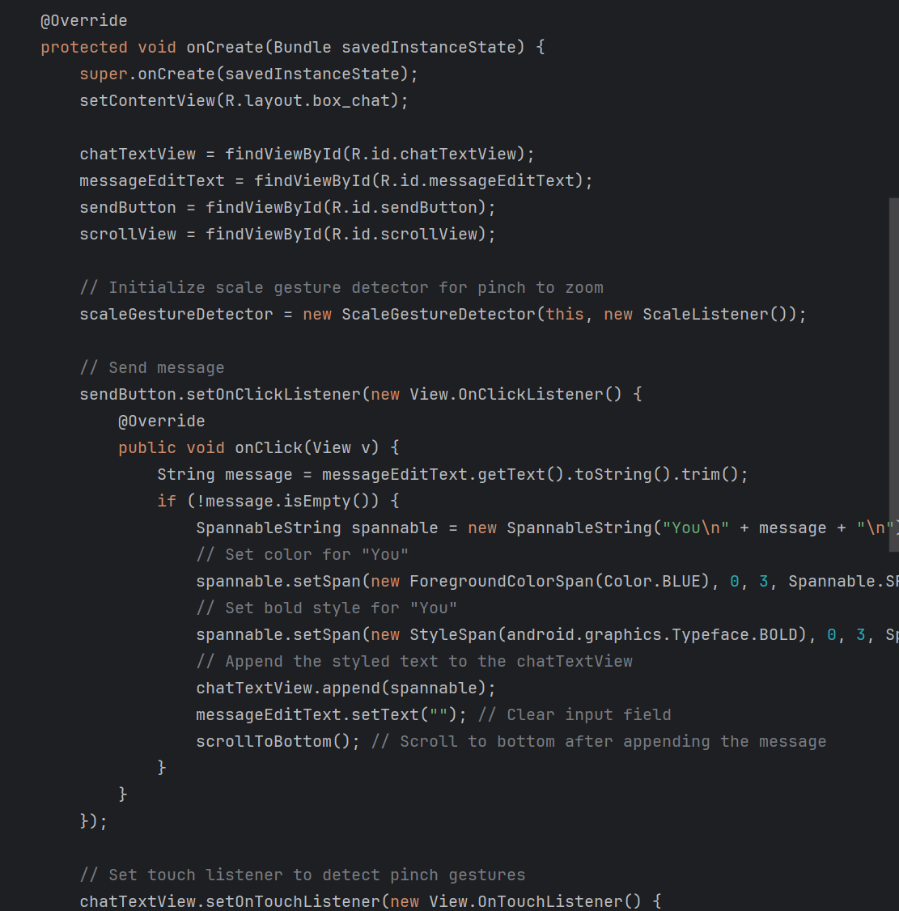
ARCHITECTURE

Slide 7
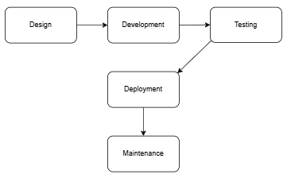
Methodology
IRC Chat App Development Process Flowchart
Development Stack :
Programming Language : Java
Framework : Gradle for build automation
IDE : Android Studio
Implementation Steps :
Design : User interface and architecture planning.
Development : Coding core functionalities.
Testing : Unit and integration testing.

Slide 8
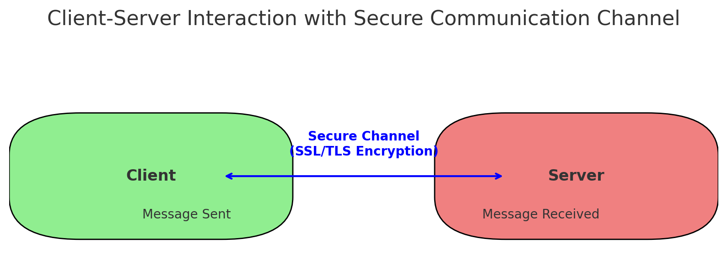
Methods
Real-Time Messaging: IRC protocol used for real-time message delivery.
Secure Connections: SSL/TLS is implemented in place for encryption.
Cross-Platform Compatibility: Ensured the application works smoothly on multiple operating systems.
Visual: Infographic showing interaction of client-server, highlighting security in communication channels.

Slide 9
Result

Slide 10
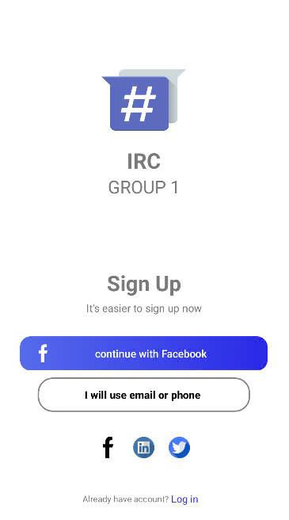
The welcome screen
For organizations or teams, it provides unified billing and the option to use a private server for team messaging.
Paid users can also connect with another IRC client using a unique password and instructions.

Slide 11
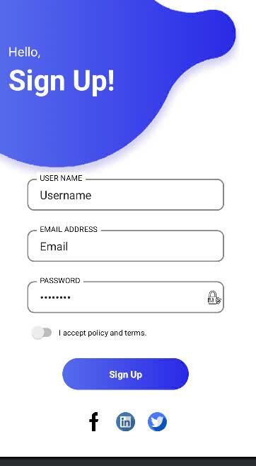
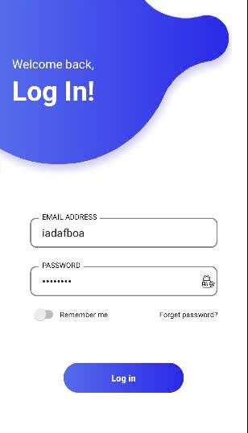
The login and signup screen

Slide 12
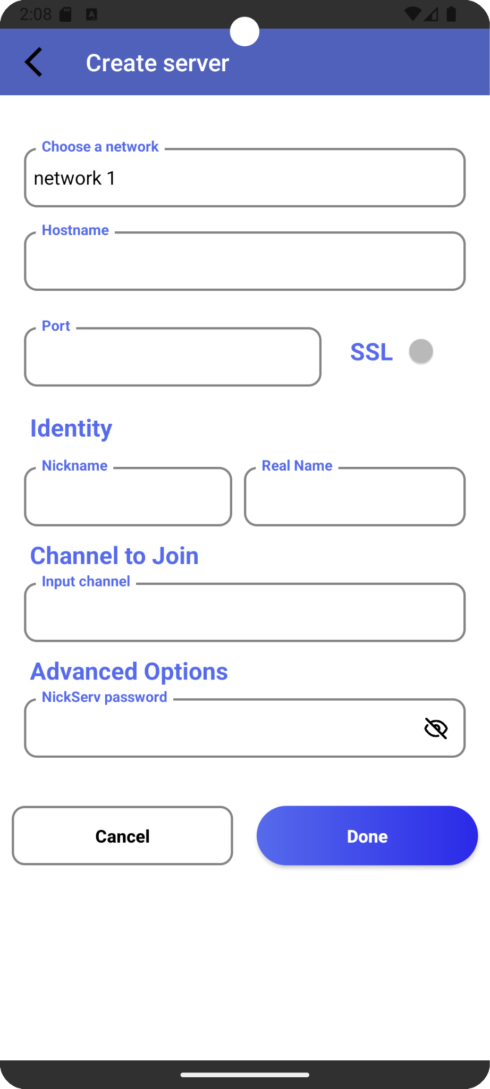
Creating servers
The "Create Server" screen lets users set up an IRC server connection by specifying a network, hostname, port, SSL, nickname, real name, channel, and NickServ password for authentication. "Cancel" and "Done" buttons complete the setup.

Slide 13
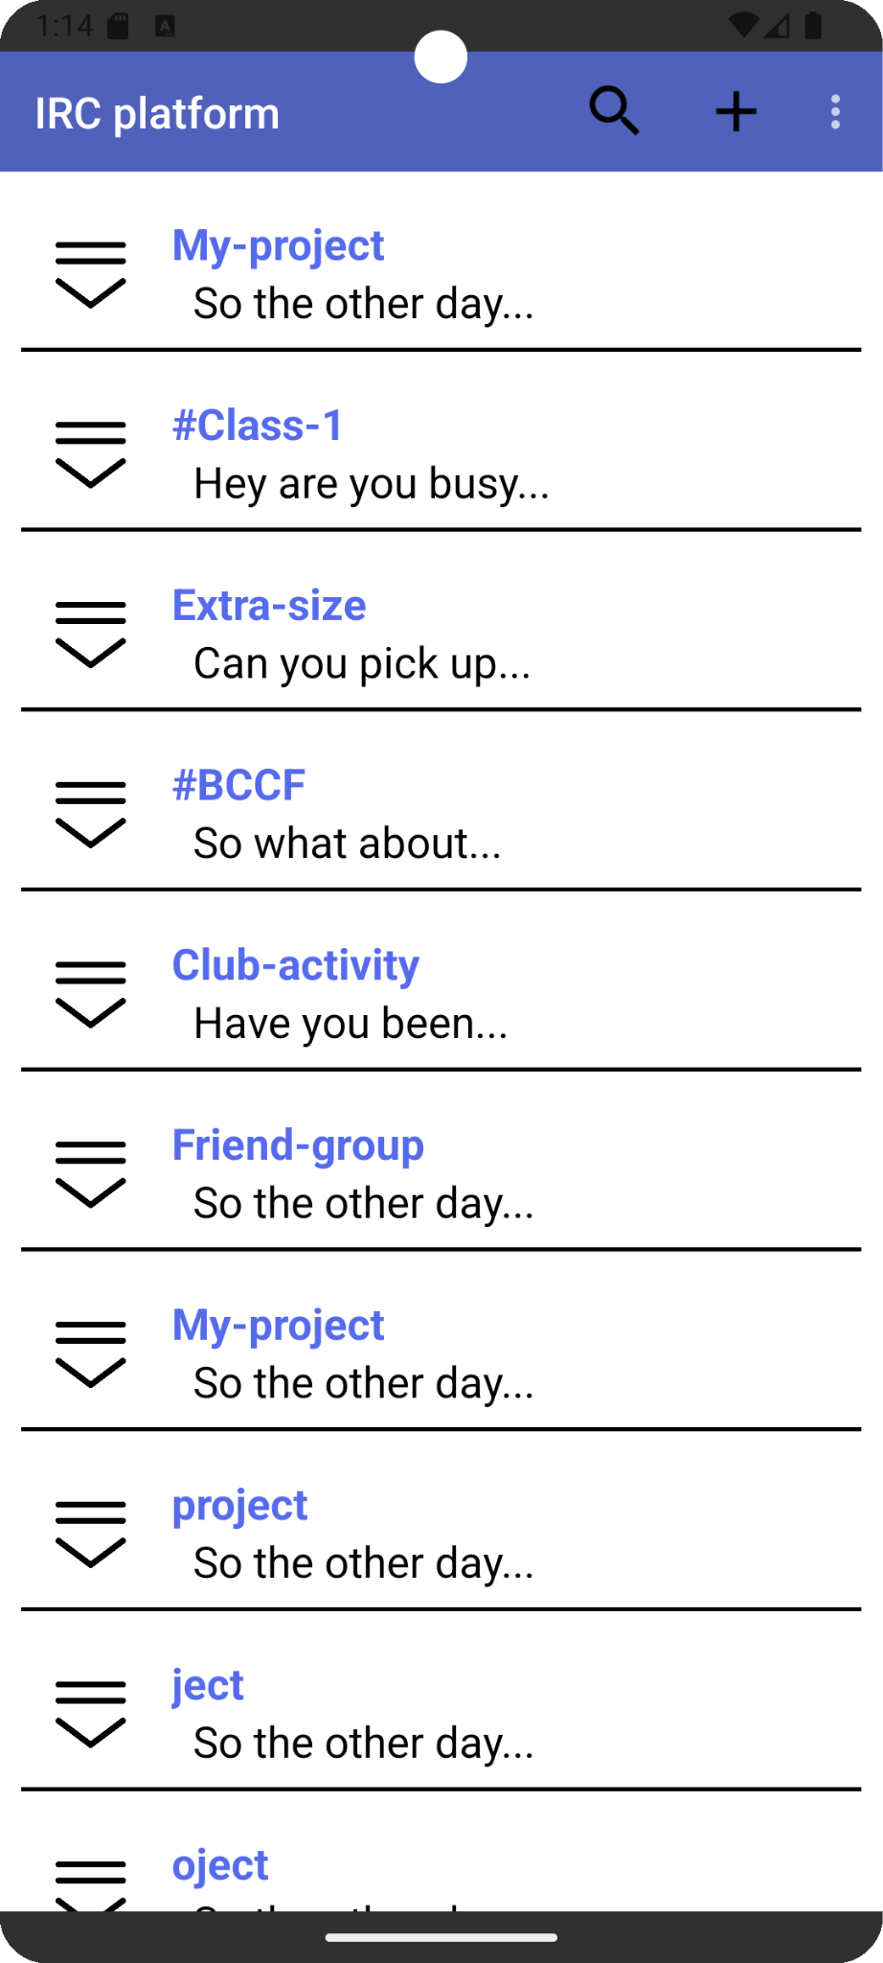
Search box
Add server/chatroom
The logout button inside
The server list
The server list

Slide 14
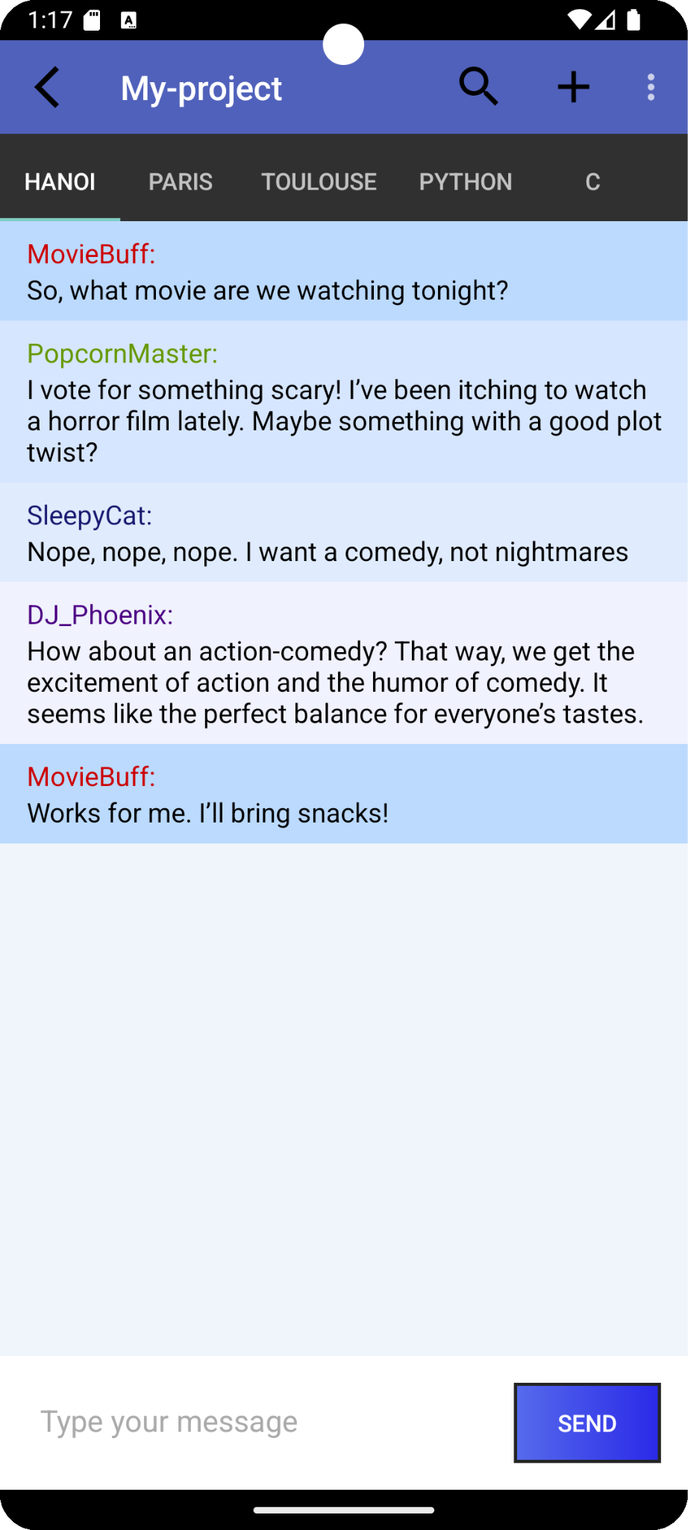
The chat boxes
The username
The message
The type bar

Slide 15
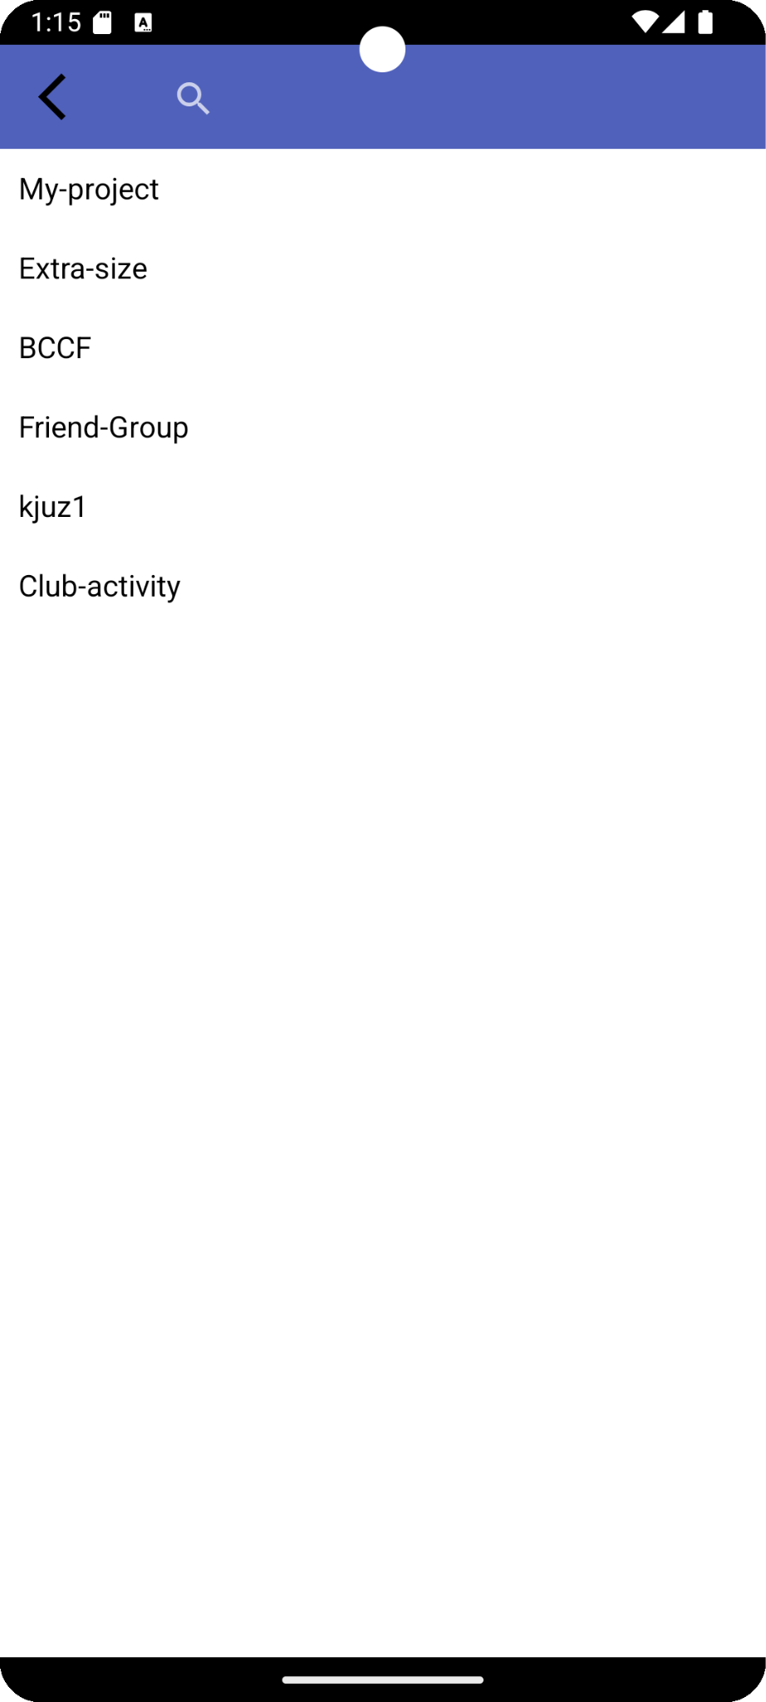
The search view
A search box is also added to the list server and fragment of a chat box for fast searching and filtering of the relevant text inside the fragment. It enhances more on accessibility and ease of navigation.

Slide 16
Conclusion
Our app starts with a familiar login and signup screen, but we’ve improved it by integrating login options through Facebook and Google.
While it retains the simplicity of Android IRC, our chat box comes with improvements like the zooming function and users can easily switch between different servers and channels.

Slide 17
Future updates
Add IRC bot integration.
Aim to add file-sharing capabilities.
Sending notifications, managing channels.

Slide 18

THANK YOU!

